Slide 1
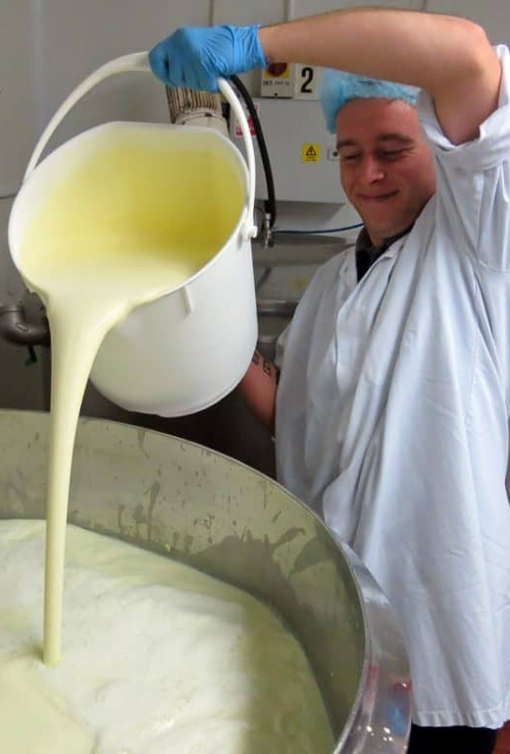
Science of Ice-Cream – Page 1
Did you ever wonder why ice cream is so wonderfully smooth and scrumptious? It's not just a delightful summer treat; it's a science experiment that you can actually eat! It all begins with basic ingredients such as milk, cream, sugar, and your favorite flavors. Imagine these as characters in our yummy ice cream story. They're mixed together in a chilly adventure, but the real magic springs to life with an unexpected hero, a dash of salt! The salt isn't there to give your ice cream a salty twist. Rather, it's the secret weapon that lowers the freezing point of the mixture. This ensures that your ice cream turns into a soft, creamy dessert you can spoon through easily, rather than a hard, icy block that your spoon can barely crack!
What are the main characters (ingredients) in our ice-cream story? ___________________________________________________________________
Who is the unexpected hero in this story and why? ___________________________________________________________________
What is the secret mission of the salt in the ice-cream mixture? ___________________________________________________________________
The process of making ice cream also involves an exciting principle called 'freezing point depression'. Sounds serious, right? But it's really cool, literally! This is the scientific way of saying that when a substance like our hero, salt, is added to another substance, like the water in our mixture, it becomes a superpower that lowers the temperature at which the water freezes. So, when you add salt to the ice cream mix, instead of turning into a tough popsicle, it maintains its creaminess and softness. The salt, like a temperature superhero, allows the mixture to become super cold without becoming solid ice. It's like the ice cream has its own personal chill zone!
What is the ‘freezing point depression’? ___________________________________________________________________
Who is our temperature superhero and what is its superpower? ___________________________________________________________________
How does this superpower influence the texture of our ice-cream? ___________________________________________________________________

Slide 2
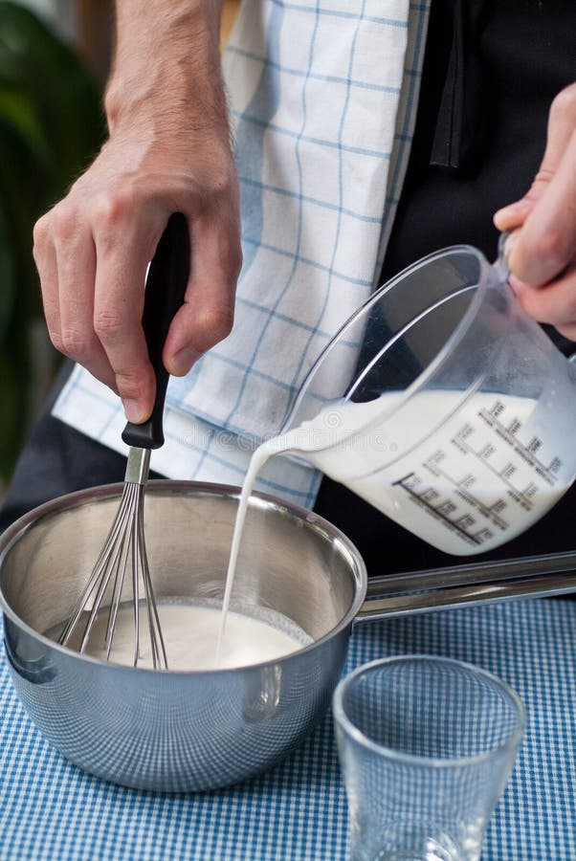
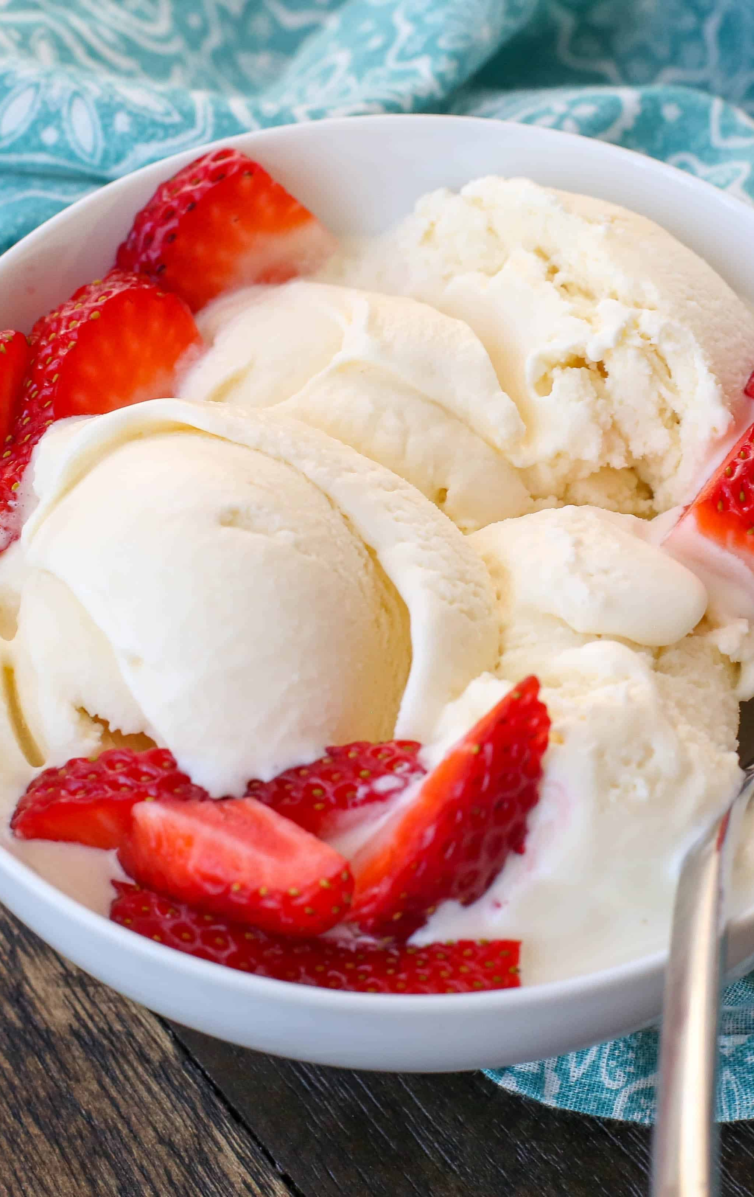
Science of Ice-Cream – Page 2
Just when you thought it couldn't get more interesting, there's also physics involved in the making of ice cream. Remember those action movies where heroes swoop in to save the day? In our story, that action comes from churning! When you churn the mixture, you're like a superhero introducing a secret weapon - air! This creates millions of tiny bubbles in the mixture that get trapped, making the ice cream fluffy and light. It's like every scoop is full of these hidden mini superheroes, which is why when you take a scoop of ice cream, it isn't as heavy as you might expect. This process, known as aeration, is another exciting adventure in the creation of your delicious frozen dessert.
What is the secret weapon introduced during this process? __________________________________________________________________
How do these mini-superheroes (bubbles) change the texture of the ice cream? __________________________________________________________________
What do you think would happen if the mixture was not churned properly? __________________________________________________________________
Finally, our scrumptious ice cream is a tale of harmony, it's an emulsion! An emulsion is a thrilling mix of two liquids that usually can't stand each other, like oil and water. In the ice cream world, these are the water in the milk and the fat in the cream. But, thanks to peacekeepers called emulsifiers, like egg yolks, these two are forced to get along! They help the water and fat mix properly, ensuring that your ice cream is a perfect blend of all its characters, not a watery mess with bits of fat floating around. This ensures that every bite of your ice cream is the perfect harmony of taste and texture.
What is an emulsion in our ice cream story? __________________________________________________________________
Who are the creatures that usually can’t stand each other in this tale? __________________________________________________________________

